Slide 1
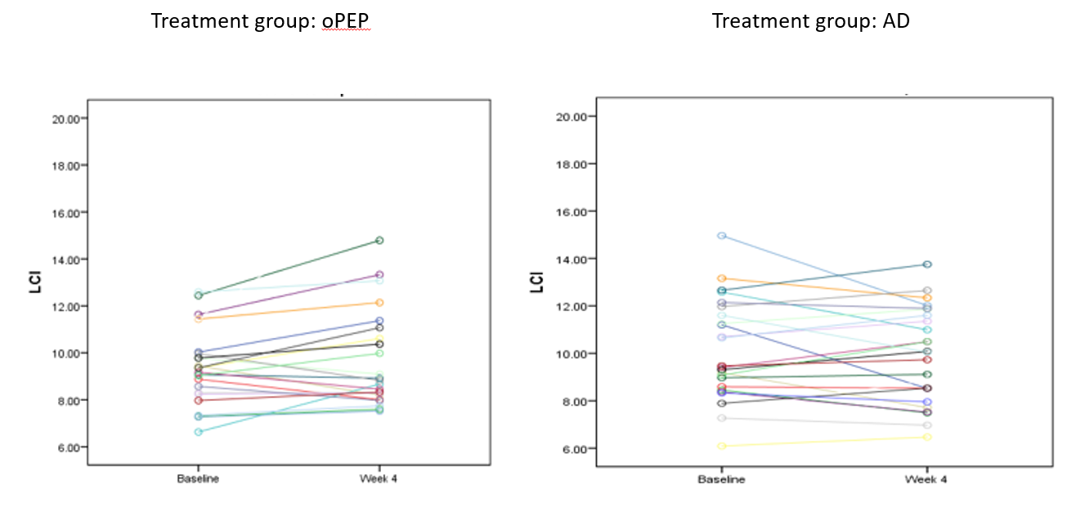
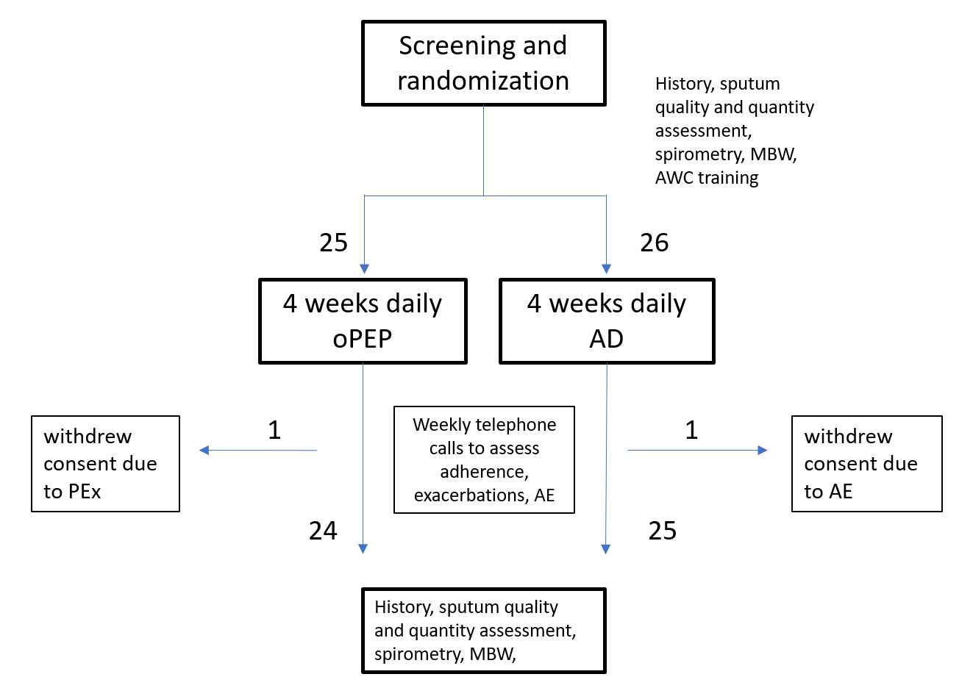
Four-week Daily Airway Clearance Using Oscillating Positive-end Expiratory Pressure Versus Autogenic Drainage in Bronchiectasis Patients: A Randomized Controlled Trial
Galit Livnat MD^{1,2,7}, Naama Yaari BPT ³, Nili Stein MPH⁴ , Lea Bentur MD ^{5,7}, Moneera Hanna⁵, Maya Harel RN⁶, Yochai Adir MD, MPH^{6,7} , Michal Shteinberg MD, PhD^{2,6,7}
1. Pediatric Pulmonology and 2. Cystic Fibrosis Center, 3. Department of Physical therapy 4. Department of Community Medicine and Epidemiology, Carmel Medical Center, Haifa, Israel; 5. Pediatric pulmonology and CF center, The Ruth Rappaport Children’s Hospital, Rambam Medical Center, Haifa, Israel; 6. Pulmonology Institute, Carmel Medical Center, Haifa, Israel, 7. Ruth and Bruce Rappaport Faculty of Medicine, Technion-Israel Institute of Technology, Haifa, Israel
Explanation
Effects on Quality of Life:
Introduction
Results
QOL | AD (n=26) |  | p-value | oPEP (n=25) |  | p-value
Domain | Baseline (median, IQR) | 4 weeks (median, IQR) |  | Baseline (median, IQR) | 4 weeks (median, IQR)
Respiratory Symptoms | 67 (44-79.5) | 70 (50-79.5) | 0.732 | 65 (46-77) | 72 (48.8-80.3) | 0.139
Physical Functioning | 60 (20-83.5) | 67 (37-86.5) | 0.393 | 53.5 (21.8-93) | 60 (36.5-87) | 0.412
Vitality | 44 (27.5-66.8) | 67 (44-67) | 0.027 | 44 (1-100) | 50 (33-67) | 0.231
Role Functioning | 73 (53-87) | 87 (56.5-93) | 0.073 | 70 (41.8-87) | 73 (48.5-80) | 0.970
Emotional Functioning | 83 (54-100) | 83 (62.5-100) | 0.611 | 79 (60.3-92) | 79 (67-98) | 0.690
Social Functioning | 50 (21-67) | 58 (37.5-76.5) | 0.042 | n=23 58 (42-83) | n=23 58 (44-75) | 0.919
Treatment Burden | n=20 56 (33-78) | n=20 44 (33-64.3) | 0.085 | n=20 56 (35.8-75.3) | n=20 56 (33.3-67) | 0.458
Health Perceptions | 42 (33-67) | 58 (42-75) | 0.177 | 33 (25-58) | 42 (33-64.8) | 0.048
Airway clearance (AWC) is a fundamental component of care in bronchiectasis, although evidence of efficacy and a comparison of AWC methods is scarce. Lung clearance index (LCI) is a promising measurement of ventilation inhomogeneity. Its responsiveness to long-term AWC has not been studied.
Aim: This study compared the effects of two methods of daily AWC over four weeks, autogenic drainage (AD) and oscillating positive airway pressure (oPEP), on LCI, spirometry, sputum quantity, and quality of life.
Baseline Characteristics of Patients:
Parameter | AD (n=26) | oPEP (n=25) | p value
Age (years, mean±SD) | 66.7±12.3 | 65.7±13.4 | 0.760
Sex (female n(%)/male n(%)) | 19 (73.1)/7(26.9) | 14(56.0)/11 (44.0) | 0.202
Lung function: FEV₁% (mean±SD) | 96.1±18.3 | 81.3±18.1 | 0.006
Lung function: FVC% (mean±SD) | 101.7±16.5 | 89.6±20.0 | 0.032
LCI (mean±SD) | 10.0±2.1 | 9.0±2.5 | 0.254
Daily sputum production: ml (median; IQR) | 17.5 (5.0; 41.3) | 15.0 (5.0;20.0) | 0.518
Sputum bacterial infection*: n (%) | 9 (34.6) | 13 (54.2) | 0.164
Sputum purulence# (0-1/2-3) | 13 (59.1)/9 (40.9) | 15 (62.5)/9 (37.5) | 0.813
Previous PEx/year (median, IQR) | n=26 2 (1;4) | n=24 1 (0;2) | 0.016
Treatment at Baseline:
ICS: n (%) | 5 (19.2) | 8 (32.0) | 0.296
LABA: n (%) | 5 (20.0) | 9 (36.0) | 0.208
LAMA: n (%) | 0 (0) | 3 (12.0) | 0.235
Hypertonic saline: n (%) | 19 (73.1) | 20 (80.0) | 0.560
Performing exercise: n (%) | 14 (53.8) | 12 (48.0) | 0.676
CT Findings:
No. of infected lobes on CT (median, IQR) | n=21 2.0(2.0,3.5) | n=20 2.0(2.0,3.75) | 0.787
Reiff index (median, IQR) | n=24 3.0(2.0,4.0) | n=25 3(2,4.5) | 0.639
Findings on auscultation:
Wheeze: No. (%) | 1 (3.8) | 3 (12.0) | 0.350
Rales: No. (%) | 9 (34.6) | 9 (36.0) | 0.918
Methods
Effects on LCI (p=0.142)
Adult patients with newly diagnosed bronchiectasis, naive to airway clearance, were randomized and instructed to perform daily AWC at home with either AD or oPEP (Aerobika, Trudell pharma, London, Ontario, Canada). Weekly phone calls were scheduled for evaluating adherence to AWC. Lung clearance index was assessed by multiple breath washout; spirometry, self-reported sputum volume, and purulence, and quality of life was were evaluated at randomization and after four weeks of AWC.
p=0.064
p=0.767
Methods
Effects of Treatment on Symptoms and Lung Function:
Study flowchart:
 | AD (n=26) | oPEP (n=25) | P value
Change in sputum purulence§: n (%) |  |  | >0.99
Improved | 4 (20) | 5 (23)
Unchanged | 13 (65) | 13 (59)
Worsened | 3 (15) | 4 (18)
Change in sputum quantity: n (%) |  |  | 0.044
Less sputum | 6 (24) | 12 (52)
More sputum | 19 (76) | 11 (48)
Sputum quantity (ml); median (range) pre-post | 17.5 (5–42.5) to 15 (5–45) | 15 (5-25) to 5 (5-20) | 0.386
FEV₁% change after four weeks: median (range) | 0.05 (-23–7.6) | 0 (-11.8–10.5) | 0.71
Conclusions:
Sputum quantity was lower in the oPEP group after one month of daily AWC, with a better treatment burden.
The effects of four weeks of AWC on LCI were not significant in either treatment group.
Clinical trial registration no. NCT03013452
Results
We thankfully acknowledge the support of Trudel pharma (London, Canada) for providing Aerobika devices and financial support for this study
Notes:
זהו פוסטר שעוסק בחולי ברונכיאקטזיס
פורסם בATS 2020
ביח הכרמל , מיכל שטיברג, יוחאי אדיר וצוות הפיזיוטרפיסטים בשיתוף עם טרודל
4 שבועות, 51 חולי ברונכיאקטזיס בעלי אבחנה חדשה, 2 זרועות מחקר, גיל ממוצע 65-66
1-טכניקה רגילה לפינוי עצמי של הפרשות
2- אירוביקה
אחת לשבוע נעשה מעקב טלפוני
מסקנות- קבוצת אירוביקה- כמות נמוכה יותר של ליחה עם מאמץ טיפולי נמוך יותר

Slide 2
Four-week Daily Airway Clearance Using Oscillating Positive-end Expiratory Pressure Versus Autogenic Drainage in Bronchiectasis Patients: A Randomized Controlled Trial
Galit Livnat MD^{1,2,7}, Naama Yaari BPT ³, Nili Stein MPH⁴ , Lea Bentur MD ^{5,7}, Moneera Hanna⁵, Maya Harel RN⁶, Yochai Adir MD, MPH^{6,7} , Michal Shteinberg MD, PhD^{2,6,7}
1. Pediatric Pulmonology and 2. Cystic Fibrosis Center, 3. Department of Physical therapy 4. Department of Community Medicine and Epidemiology, Carmel Medical Center, Haifa, Israel; 5. Pediatric pulmonology and CF center, The Ruth Rappaport Children’s Hospital, Rambam Medical Center, Haifa, Israel; 6. Pulmonology Institute, Carmel Medical Center, Haifa, Israel, 7. Ruth and Bruce Rappaport Faculty of Medicine, Technion-Israel Institute of Technology, Haifa, Israel
 | AD (n=26) | oPEP (n=25) | P value
Change in sputum purulence§: n (%) |  |  | >0.99
Improved | 4 (20) | 5 (23)
Unchanged | 13 (65) | 13 (59)
Worsened | 3 (15) | 4 (18)
Change in sputum quantity: n (%) |  |  | 0.044
Less sputum | 6 (24) | 12 (52)
More sputum | 19 (76) | 11 (48)
Change in sputum quantity (ml); median (range) | 17.5 (5-42.5) to 15 (5–45) | 15 (5-25) to 5 (5-20) | 0.386
FEV₁% change after four weeks: median (range) | 0.05 (-23–7.6) | 0 (-11.8–10.5) | 0.71
Sputum quantity was lower in the oPEP group after one month of daily AWC, with a better treatment burden.
The effects of four weeks of AWC on LCI were not significant in either treatment group.
Results
Notes:
זהו פוסטר שעוסק בחולי ברונכיאקטזיס
פורסם בATS 2020
ביח הכרמל , מיכל שטיברג, יוחאי אדיר וצוות הפיזיוטרפיסטים בשיתוף עם טרודל
4 שבועות, 51 חולי ברונכיאקטזיס בעלי אבחנה חדשה, 2 זרועות מחקר, גיל ממוצע 65-66
1-טכניקה רגילה לפינוי עצמי של הפרשות
2- אירוביקה
אחת לשבוע נעשה מעקב טלפוני
מסקנות- קבוצת אירוביקה- כמות נמוכה יותר של ליחה עם מאמץ טיפולי נמוך יותר

